Slide 1

Process Mining Virtual Internship
by
S.JAHEDA
Roll No. 204G1A3229
Department of Computer Science and Engineering (Data Science)
Srinivasa Ramanujan Institute of Technology
(Affiliated to JNTUA & Approved by AICTE) (Accredited by NAAC with ‘A’ Grade & Accredited by NBA (EEE, ECE & CSE)
Rotarypuram Village, B K Samudram Mandal, Ananthapuramu – 515701.
2023 - 2024

Slide 2
Contents
Course Objective
Introduction
Technology
Applications
Modules
Real Time applications
Learning outcomes
GitHub Link
Queries

Slide 3
Course Objective
The goal of process mining is to improve the performance of business processes and make data-driven decisions about their design and implementation.
understand the three major types of process mining :Discovery,Conformance, and Enhancement.
Learn how to prepare and aggregate data from system of record(databases) to generate Event logs.
Learn the robust data-driven approach for Process optimization.
Learn the relatively new process improvement discipline:through discovering real process maps from event logs

Slide 4
Introduction
Process Mining Virtual Internship is offered by Eduskills Foundations with the support of Celonis Academy. It is a non-profitable organization which provides the resources to improve the technical knowledge. The Academic Alliance offers students the chance to learn about Process Mining and upskill for their future career. They offer students free access to the Celonis technology for the purpose of learning and classroom work as well as online certifications, thesis support etc.
Celonis is a data processing company that sells software as a service (SaaS) to improve business processes. Its headquarters are in Munich, Germany, and New York, USA. Celonis is the global leader in process mining. Celonis Process Mining provides companies a modern way to run their business processes entirely on data and intelligence. They pioneered the process mining category 10 years ago when they first developed the ability to automatically X-ray processes and find inefficiencies.

Slide 5
Introduction
process :
A process is a series of steps and decisions involved in the way work is completed.
The purpose of a process is to establish and maintain a commonly understood flow that allows a task to be completed as efficiently and consistently as possible.
Process Mining:
Process mining is a technique to analyze and track processes. In traditional business process management, it is done with process workshops and interviews, which results in an idealized picture of a process.
Process mining is a widely-used technology to model, analyze, and optimize business processes.

Slide 6
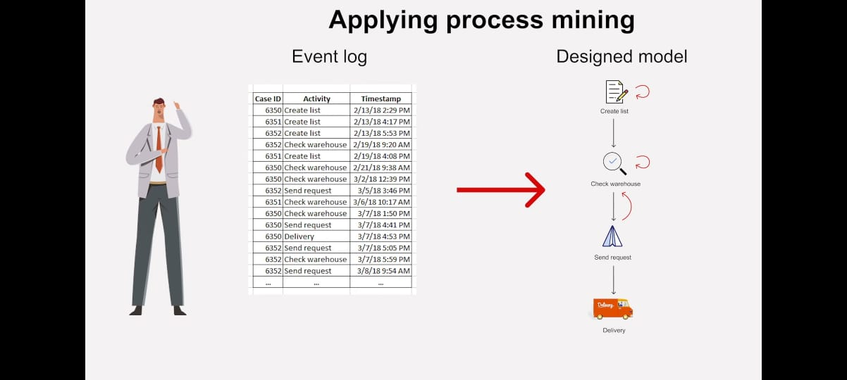
Introduction
Example:
Super Market Store delievery conditions before and after increasing the sales and orders.
This situation can be managed with the help of process mining.
By analysing the root delivery late causes for
an order, and taking necessary steps to
minimize them.
The steps which take more time in the
process of delivery are taken care of.

Slide 7
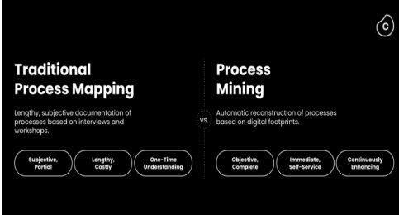
Technology
Process Mining is the leading new technology when it comes to talking about algorithmic businesses - in other words, businesses that use algorithms and large amounts of real-time data to create business value. This has only become possible through the advent of information systems and administrative tools (e.g. Enterprise Resource Planning or Customer Relationship Management systems) which provide a good data source for process analytics. Process Mining is a solution to costly and time-intense efforts to get data-driven insights into a business.
Compared to the traditional process mapping
approaches,Process Mining technology solves the
complexity and visibility problem.
This allows businesses to better field requests
from their stakeholders because they can have
confidence in the data.

Slide 8
Technology
Types of process mining:
❖ Discovery
❖ Conformance
❖ Enhancement
Process discovery
The discovery technique extracts data from the event log and uses it to produce a new model. Using this information, the mining software generates a process map that contains an analysis of various processes. This strategy can allow executives to scrutinise data and help them work towards improving organisational workflows.

Slide 9
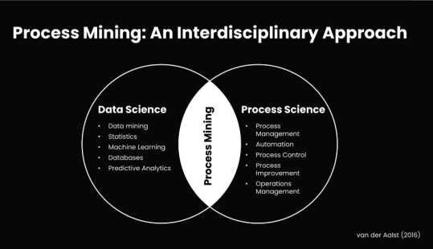
Technology
Process Mining is the combination of two disciplines: Data Science and Business Process Management. Process Mining essentially uses Data Science techniques, such as Big Data and AI, to address Process Science problems such as process improvement and automation. Process Mining technology can identify patterns and deviations and ultimately eliminate bottlenecks.
Process mining starts from event data. Input for process mining is an event log.
An event log views a process from a particular angle.
Each event in the log should contain
A unique identifier for a particular process instance
(called case ID)
an activity (description of the event that is occurring)
a timestamp.

Slide 10
Technology
Conformance checking
The conformance technique allows your mining software to compare your processes with a pre-existing model. It utilises data from event logs and shows how a business process can achieve optimal working conditions. The mining software then compares the pre-existing models with your workflow to identify further areas of improvement.
Enhancement
The enhancement strategy aims to optimise pre-existing models using additional information. Performance mining can constantly try to improve former systems with data from organisational logs. It allows both your pre-existing and actual workflows to be accurate and efficient.

Slide 11
Applications
Fitness and Health: By analyzing your exercise and dietary habits, process mining can provide insights into your fitness journey, helping you adjust your routines for better results.
Home Automation: Process mining can be used to analyze your interactions with smart home devices, enabling you to optimize energy consumption and automate tasks more effectively.
Cooking and Meal Planning: Process mining can analyze your cooking processes and meal planning habits, helping you streamline your cooking routines and discover new recipes.
Study and Learning: Process mining can assist in analyzing your study habits, identifying areas for improvement, and suggesting effective learning strategies
Health Tracking: If you use health tracking apps or devices, process mining can analyze your health data and provide insights into your fitness and well-being.

Slide 12
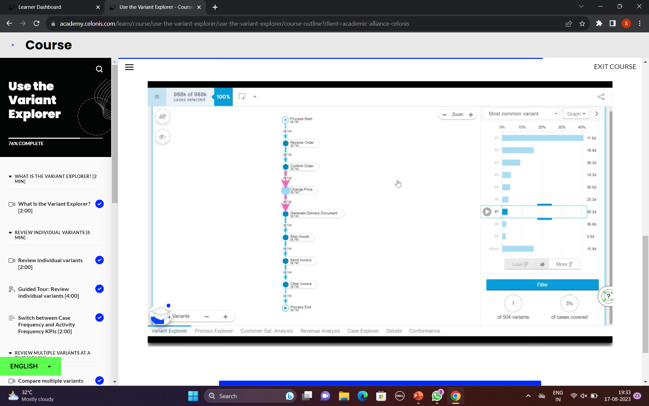
Modules
Set of techniques used for obtaining knowledge and extracting insights from processes by the means of analyzing the event data, generated during the execution of the process.
Variant explorer
Process explorer
Charts & Tables
Variant Explorer
Discover all the process variants-that is all the different ways the process flows in your organization.
By using Variant Explorer,you can get a quick sense of
whether most cases follow an acceptable flow of
activities or not.

Slide 13
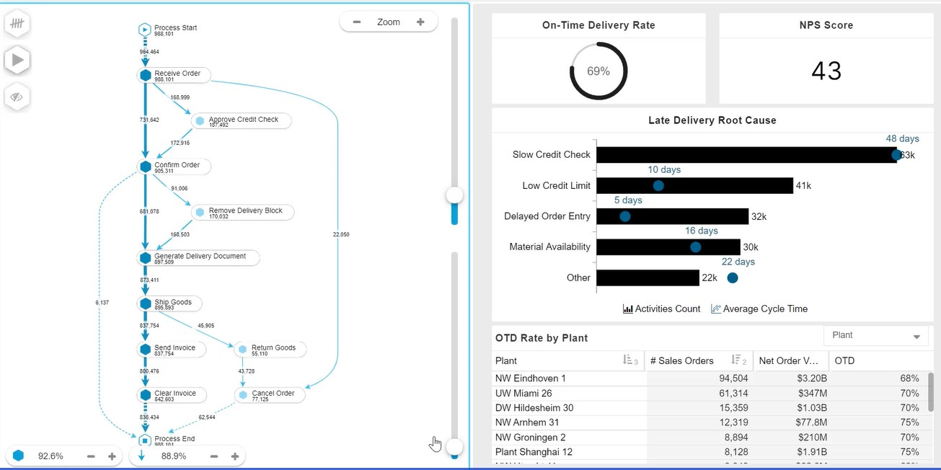
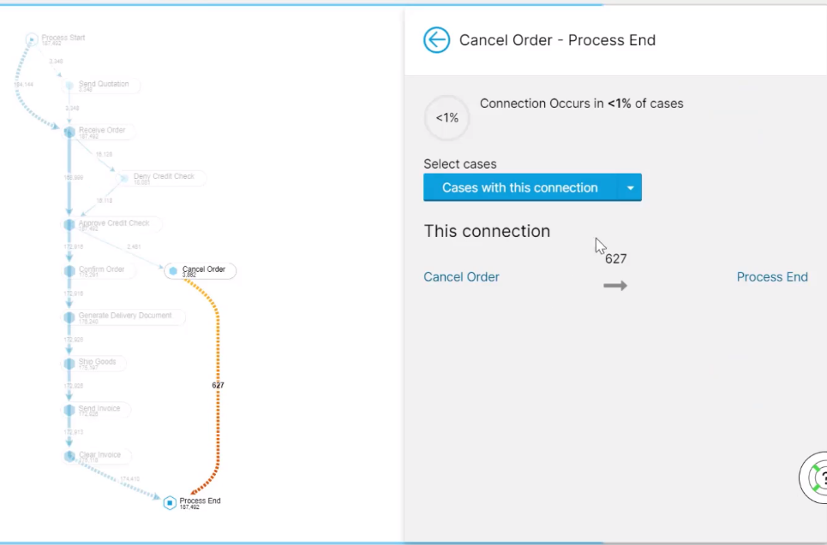
Modules
Process Explorer
To see which activities cases typically come from and which activities they're going to.
Find outs the flow of undesired/unwanted activities.

Slide 14
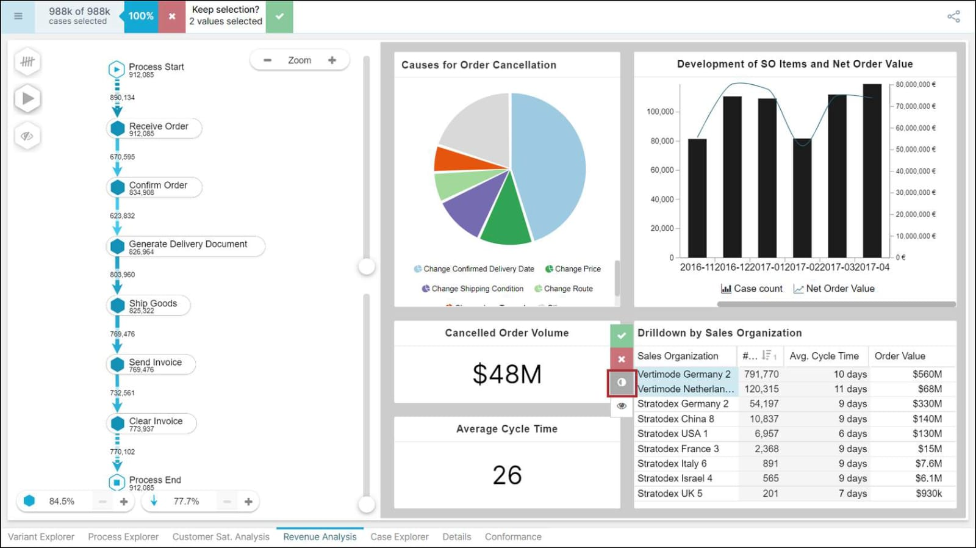
Modules
Charts & Tables
Anytime you add a table or chart to the analysis, you'll need to select the dimension(s) and KPI(s) to display.
Data is analysed in an organized manner.
In pie chart , KPI (Key Performance Indicators) are selected.
In Bar graphs, dimensions are selected.

Slide 15
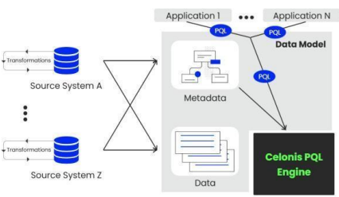
Modules
PQL Queries
Celonis PQL is an integral component of the Celonis Software Architecture.
All Celonis applications use this language to query data
from a data model.
Celonis PQL follows four language features:
First, operators usually create and return a single column that is either added to an existing table (e.g., the case or activity table) or to a new, temporary result table.
Second, the supported data types comprise STRING, INT, FLOAT, and DATE.
Third, Boolean values are not directly supported, but can be represented as integers.
Fourth, each data type can hold NULL values. Celonis PQL operates.

Slide 16
Learning Outcomes
After you complete this training, you should be able to:
Understood what process mining is and the basics of how it works.
Identified business use cases for process mining.
Learnt how to find training courses to get started.
Understood how to discover, analyze, and improve business processes using data driven techniques.
learnt to identify bottlenecks, inefficiencies, and opportunities for optimization.
learnt to extract to create visual representations of processes to aid decision making and process improvement efforts.
Also gained skills in using process mining tools and interpreting the results to enhance organizational efficiency and effectiveness.

Slide 17
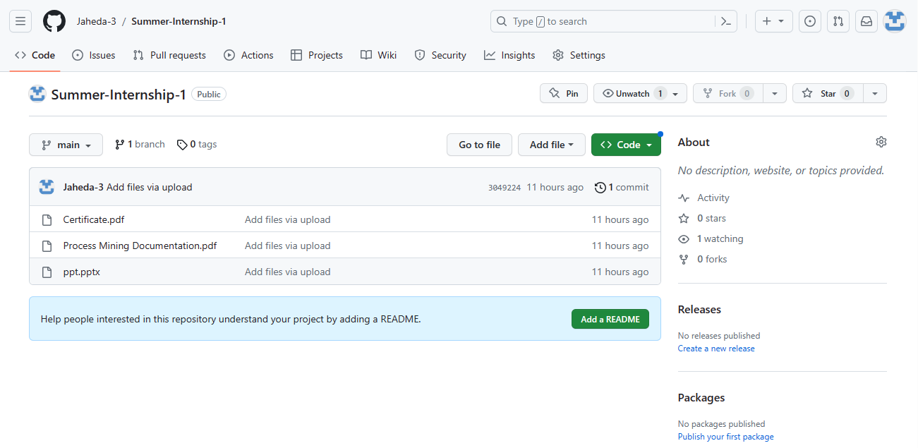
Git Hub Dashboard

Slide 18
Any Queries?

Slide 19
Thank You!!!

